Slide 1
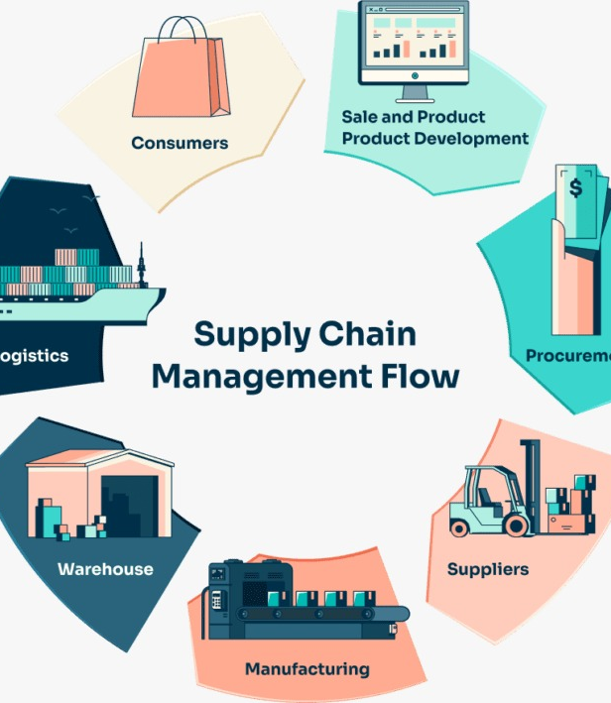
SUPPLY CHAIN MANAGEMENT

Slide 2
Introduction
Supply Chain Management (SCM) plays a pivotal role in today's interconnected global economy, serving as the backbone of businesses across industries.
In this project, we utilized a combination of tools including Excel, Power BI, and Tableau to analyze, visualize, and optimize various aspects of the supply chain. Excel provided us with robust data manipulation capabilities and basic analytics functionalities, while Power BI and Tableau allowed us to create dynamic dashboards and interactive visualizations for deeper insights into supply chain performance.
By leveraging these tools, we were able to make data-driven decisions, identify areas for improvement, and drive efficiencies throughout the supply chain, ultimately enhancing overall operational effectiveness and customer satisfaction.

Slide 3
Project flow can be defined by the following steps :
Data Cleaning/Merging in Excel
Dashboard Creation in Excel
Dashboard Creation in Power BI
Dashboard Creation in Tableau
Key Insights

Slide 4
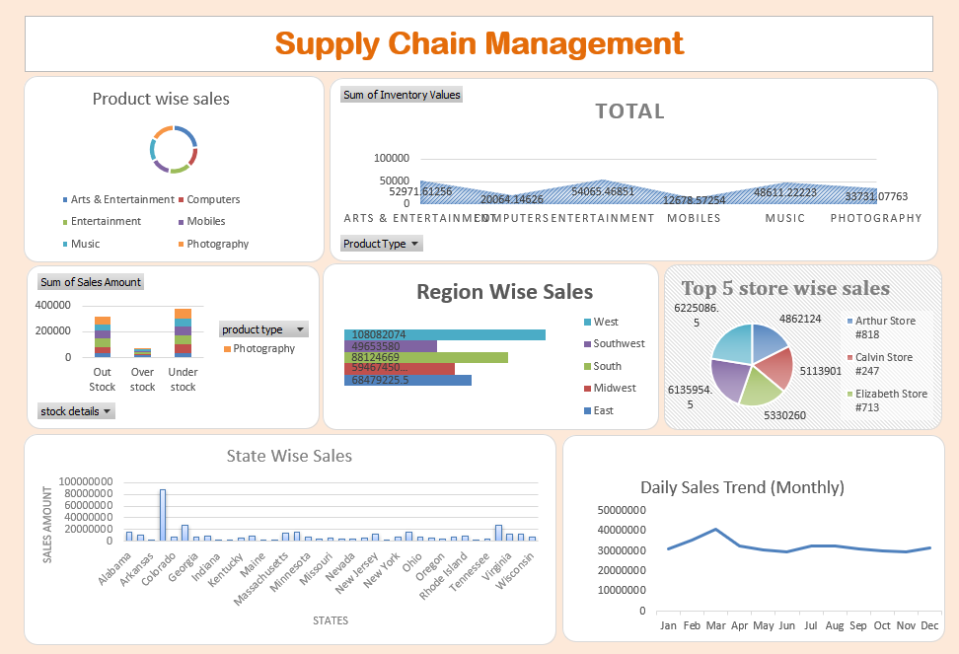
Excel Dashboard

Slide 5

Challenges in Excel
Data Cleansing and Formatting: Dealing with inconsistent formats and errors in raw data.
Handling Large Datasets: Excel's limitations in efficiently managing large amounts of data.
Formula Errors: Identifying and resolving errors in formulas.
Version Control: Managing versions of Excel files in collaborative projects.
Data Visualization: Limited charting features for complex data visualization.
Complex Analysis Requirements: Need for advanced functions or additional tools for complex analysis.
Data Security and Privacy: Ensuring data security and compliance with regulations in Excel files.

Slide 6
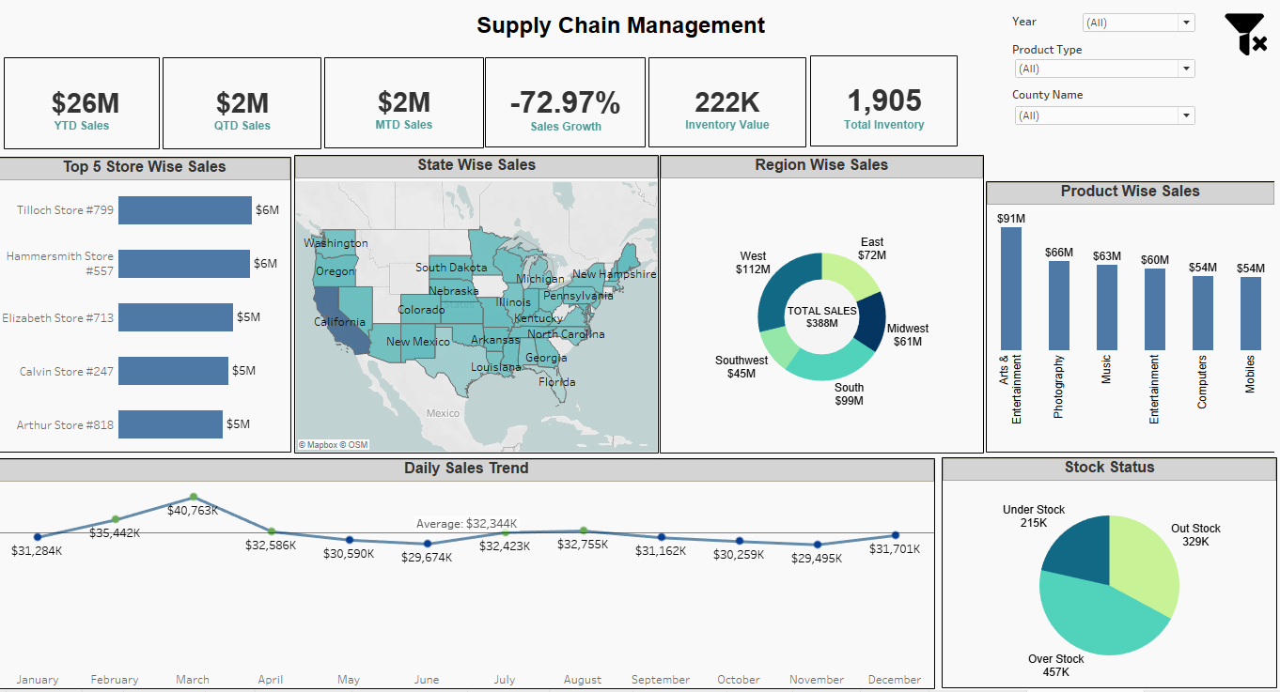
Tableau Dashboard

Slide 7
Challenges in Tableau
Data Complexity: loading, processing, or visualizing large volumes of data or complex data may lead to slower performance or system crashes.
Data Processing: While it offers basic data cleansing, transformation, and modelling features, complex data manipulation tasks may require additional tools or preprocessing steps outside of Tableau.
Static and single value parameters: whenever the data gets changed, a manual update is required since the parameters are static and only a single value can be selected while using parameters.
Offline Access: It relies on live connections or extracts of data for visualization and analysis, which may limit offline access to data and dashboards.
Screen Resolution on Tableau Dashboards: The layout of the dashboards gets disturbed if the tableau developer’s screen resolution is different from end user’s screen.

Slide 8
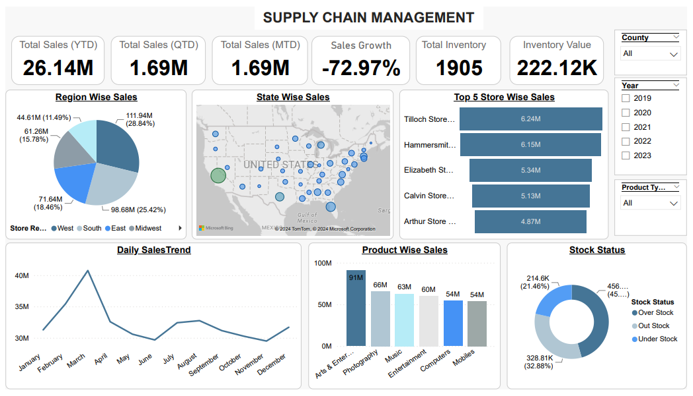
Power BI Dashboard

Slide 9
Challenges in Power BI
Data Integration: Supply chain data often comes from diverse sources such as ERP systems, logistics platforms, and IoT devices. Integrating and harmonizing this data for analysis can be complex, requiring expertise in data modeling and ETL processes.
Effective Visualization Design: Designing effective visuals requires an understanding of data visualization principles, user requirements, and best practices to avoid common pitfalls like cluttered or misleading charts.
Mastery of DAX (Data Analysis Expressions): Mastering DAX requires learning its syntax, functions, and best practices, as well as understanding how to apply it effectively to solve analytical challenges and business requirements.
Ensuring Scalability and Performance as Data Volumes Grow: Power BI solutions must be able to scale to accommodate growing data volumes and user demands without sacrificing performance. This involves designing scalable data models, optimizing queries, and leveraging the aggregations of handling large datasets.

Slide 10


Sales growth in negative
Momentum of Supply chain is slowing down
Sales growth is highest in the month of March
More focus on the West and Midwest region
Products are overstocked in the inventory
Supply is high and demand is very low
Highest sales in Arts & Entertainment and lowest in Mobiles
KEY FINDINGS

Slide 11
Suggestions
Maximize Sales from Top Stores: Develop targeted marketing and sales strategies to maximize revenue from the top-performing stores and replicate successful practices in other locations.
Strengthen Daily Sales Trend: Stabilize and strengthen the daily sales trend by identifying and addressing factors contributing to fluctuations in sales between 30M and 40M.
Enhance Regional and state-wise Sales: Focus on enhancing sales performance in regions or states with lower sales percentages to achieve a more balanced revenue distribution across different geographical areas.
Optimize Inventory Management Practices: Improve inventory management practices by reducing excess inventory, enhancing inventory turnover rates, and aligning inventory levels with demand to optimize overall inventory performance.
Diversify Product Sales: Implement strategies to diversify product sales by focusing on product categories with lower sales percentages and increasing market share for those products.

Slide 12




Thank You

